Slide 1
attention is just a fancy name for weighted average
0 sadness
1 joy
2 love
3 anger
4 fear
5 surprise

Slide 2
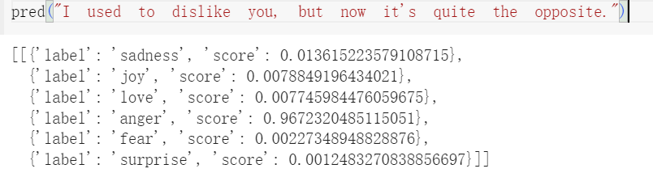
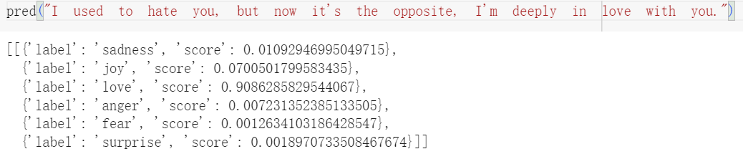

Slide 3
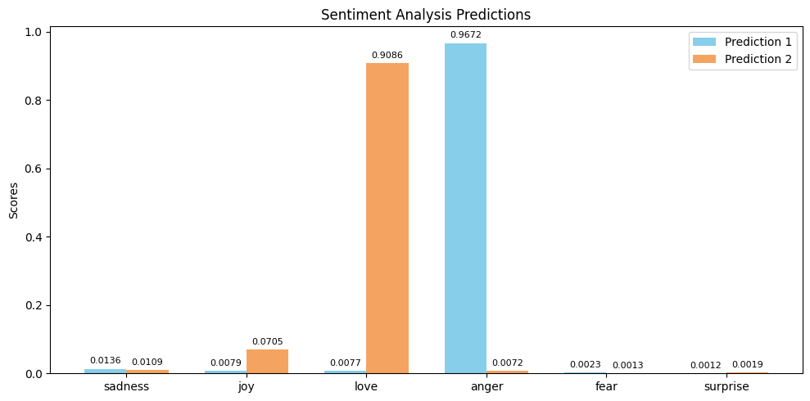
[[{'label': 'sadness', 'score': 0.01092946995049715}, {'label': 'joy', 'score': 0.0700501799583435}, {'label': 'love', 'score': 0.9086285829544067}, {'label': 'anger', 'score': 0.007231352385133505}, {'label': 'fear', 'score': 0.0012634103186428547}, {'label': 'surprise', 'score': 0.0018970733508467674}]]

